Slide 1
JNCIS-ENT
Layer 2 switching and VLANs

Slide 2
Spanning Tree Lab
6
Configuration and Monitoring of RSTP

Slide 3
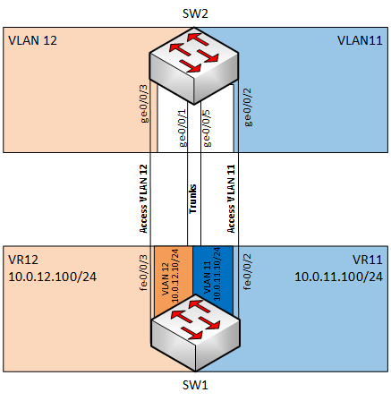
Diagram

Slide 4
Configuring RSTP
Review the starting configuration on SW1 and SW2
On SW2
On SW2, copy the ge-0/0/1 trunk configuration to ge-0/0/5
Commit the configuration and-quit configuration mode
On SW1
Ping the interfaces in the two routing instances from the default instance
Review the configuration under the protocols rstp hierarchy
Activate the protocols rstp configuration
Review the fe-0/0/5 interface configuration
Activate the fe-0/0/5 interface configuration
Review the configuration changes and commit and-quit configuration mode

Slide 5
Configuring RSTP
On SW2
Configure ge-0/0/1-3 and ge-0/0/5 to participate in rstp as point-to-point interfaces
Review the configuration changes and commit and-quit configuration mode
Review the spanning-tree bridge information
Review the spanning-tree interface information
On SW1
1. Ping the interfaces in the two routing instances from the default instance

Slide 6
Configuring a Loop
On SW2
Delete the protocols rstp configuration
Commit and-quit configuration mode
On SW1
Review the current packets per second throughput on the trunk interfaces
Clear the ARP table
Ping one of the interfaces in the routing instances from the default instance
Review the current packets per second throughput on the trunk interfaces

